Slide 1
Examining the Use of Advanced Programming Constructs
11th June 2021
Luca Davies – M.Sci. (Hons.) Computer Science (with Industrial Experience)
Notes:
Good morning, I hope you’re both fairing well…

Slide 2
Objectives
To understand:
the usage of seven advanced programming language constructs
the what and why of developers use of these constructs
the use in practice, in real codebases
the effect the constructs have on compiled intermediate languages
Notes:
Primary objectives are…
Secondary of measuring *actual* performance with profiling and benchmarking tools

Slide 3
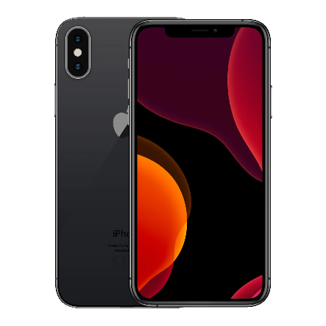
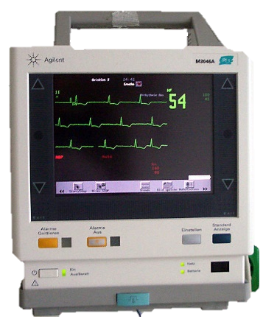
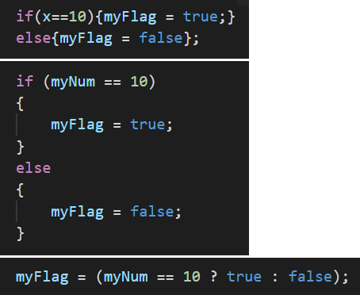


Why?
iPhone X from Apple Inc.
Tesla Model S from Tesla Inc.
Saminoo Data Base Marketing Board by Katrina.Tuliao, Creative Commons Attribution 2.0 Generic licence
medical monitor Agilent M3046A by Pflegewiki-User Würfel, GFDL
So much is computer controlled
Getting it right is increasingly important
Good style and structure keeps code simple and easy to read
Plenty of guidance for structure, much less for using language features
Notes:
Computing and programming required everywhere, always
Increasingly so
Writing good and understandable always a battle
Brace style, indents, well documented (albeit still argued), physical structure talked about
Meta-layer above, of how we use the tools available in languages, talked about less
Seeing particular examples in LUSI codebase (sparked the thought)
Research showed very little published work

Slide 4












What? Advanced Programming Languages Constructs
The use of syntax structures that allow simplification of code…
Ternary/in-line if-statements
Null-coalesce operator
Null-conditional operators
Lambda expressions
Foreach loops
Unary Increment operators
Compound assignment operators

Slide 5


Methods
Qualtrics logo from Qualtrics
SonarQube logo from SonarQube
Semgrep logo from Return To Corporation
See Sec. 3
Survey
Gather quantitative and qualitative data
The what/where/when-type questions
Static Code Analysis
SonarQube & Semgrep
Git Commit Analysis
Regex to find interesting commits, classifying changes per construct
Intermediate Language Comparison
C# to CIL and Java to Bytecode, with and without constructs
Notes:
Survey
What constructs are they aware of, do they use them, if so where -> why
Simplicity? Clarity? House style? Quicker?
Free form text at end
Static analysis
SonarQube & sempgrep
Take form active open source code repos
Control files
Programmatic tools, patterns matching, seen in CI/CD toolchains
Git commits
Use keywords for each construct to search ALL commit messages, investigate all returned
IL Comp.
Comparing with/without, and (less so) C# vs. Java

Slide 6
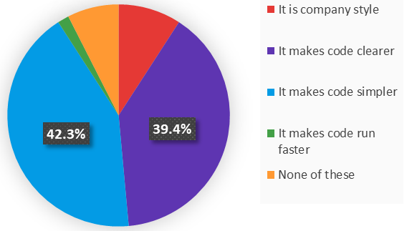
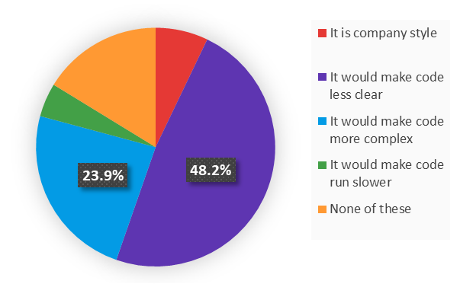
Findings: 1 - Influences on Developers
See Sec. 5.1
Why to or to not use constructs
Clarity and simplicity
Personal preference
Not company style guides
Performance
Most responses: “Don’t know”
Foreach: slow, lambdas: fast
Some constructs are always used by some developers (unary, compound operators)
Results from static code analysis were inconclusive
Notes:
Free-form text -> personal pref.
Style picked up in early programming days

Slide 7




Findings: 2 – Construct Use in Real Code
.NET Framework logo from Wikipedia
Checkstyle logo from checkstyle.sourceforge.io
npm logo from Wikipedia
Signal logo from signal.org
See Sec. 5.1
Static analysis, inconclusive
Manual commit analysis
22 relevant commits, 1537 relevant changes
1433 changes replacing plain syntax with a construct
27 changes replacing construct with plain syntax
Most changes from Winforms repo, minority from other three repos
441 get {…} / set {…} blocks to lambda and 441 if-statement null-checks to null coalesce
Notes:
Dotnet Winforms, Java Checkstyle, Signal Server, Node package manager command line interface

Slide 8
Findings: 3 – Effects of Constructs on Compiled Code
See Sec. 5.1
C#
Performed more optimisation
Used stack only for null-coalesce/-conditional
Java
A lot of one-to-one translation
iinc instruction used for unary increment and compound assignment addition
General
Lambdas and foreach loops required significant boilerplate to function
All constructs produced at least slightly different code to plain syntax – none are s

Slide 9
Limitations
See Sec. 5.3
Lambdas
Noted both in figures and survey responses to be more complex than given credit for
Survey Generalisability
Small sample size
From one organisation
GitHub Repositories
Most data came from a single commit
Small number of repos
Error in selection process

Slide 10
Summary
Findings
Clear patterns in a small group of developers, based on preference
Strong presence of habitual use of constructs over plain syntax
None of the constructs are pure syntax substitutions, they function differently
Future Research
Broader, more diverse surveys
More production code repositories
Performance profiling

Slide 11
Questions…
11th June 2021
Luca Davies – M.Sci. (Hons.) Computer Science (with Industrial Experience)

